Slide 1
Effects of Radiation on Humans

Slide 2
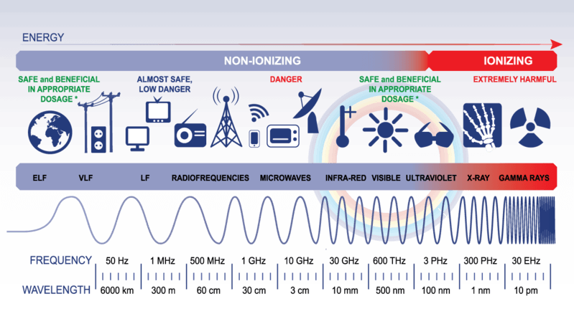
By the end of this Smart Lesson, you should be able to:
Explain what ionising radiation is and the effect that it can have on living cells.
Compare and contrast the ionising abilities of the different types of radiation.
Identify the units for radiation dose.

Slide 3
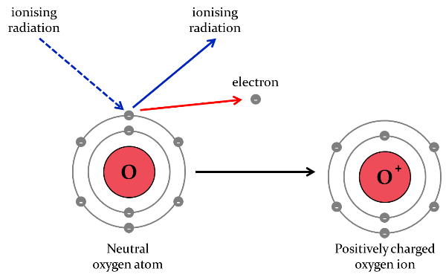
Remember, ions are formed when atoms or molecules gain or lose electrons to become charged.
Alpha, beta and gamma radiation are all ionising, which means that when they bump into atoms or molecules they can knock electrons off them, forming ions.

Slide 4
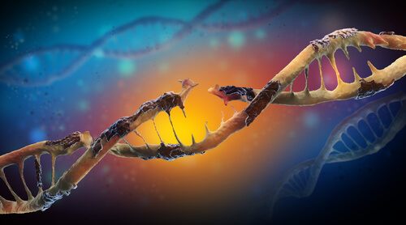
When ionising radiation enters living cells, it can destroy the biological molecules inside or form ions which then go on to react with other molecules.
These unwanted reactions cause damage to the cells and can kill them.

Slide 5
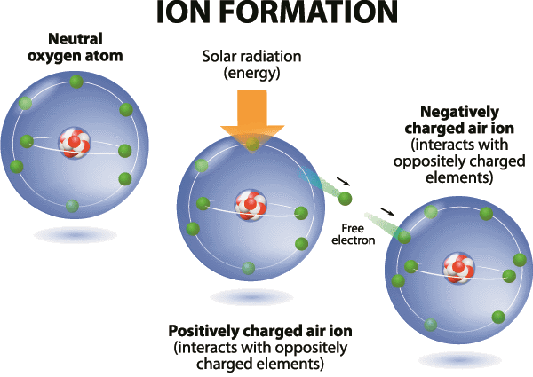
The different types of radiation have different ionising abilities.
The ionising ability is the ability of the radiation to knock electrons off atoms or molecules.
The ionising ability depends on the mass and charge of the particle. The greater the mass and charge, the more easily it can knock electrons off, therefore the more ionising the radiation.

Slide 6
The three different types of ionising radiation each have a different ionising ability.
Alpha radiation has a high ionising ability because alpha particles are large and have a +2 charge. Alpha particles cause the most damage to living tissues.
Beta radiation has a moderate ionising ability because beta particles are smaller and have a −1 charge. They cause less damage to living tissues.
Gamma radiation has a low ionising ability because gamma rays have no mass and no charge. Gamma rays cause the least damage to living tissues out of these three types of radiation. However, they do still cause damage!

Slide 7
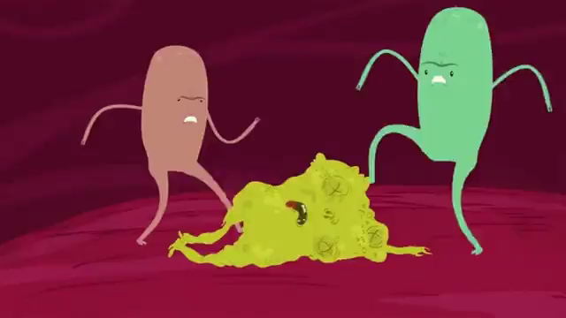
Exposing living cells to ionising radiation can cause the cells to mutate or die.
When the biological molecules in a cell are damaged beyond repair, the cell dies. This can cause radiation burns or radiation sickness.
When the ionising radiation damages the DNA inside the cell without killing the cell, it causes mutations. These mutations can cause things like cancer.

Slide 8
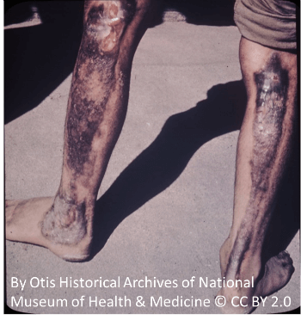
Radiation burns are caused by short exposure to large amounts of ionising radiation.
Cells on the surface of the skin are damaged, causing redness and blistering. It can take a few days for the redness to appear and up to 3 weeks for the blisters to appear. It can look like a severe case of sunburn, because sunburn is a form of radiation burn caused by radiation from the Sun.

Slide 9

Radiation sickness, or radiation poisoning, is caused by short exposure to a large amount of radiation, or exposure to a smaller amount of radiation over a longer time.
The symptoms of radiation sickness include nausea, vomiting, diarrhoea, fever and hair loss. The severity of the symptoms depends on how much radiation is absorbed. They will also appear more quickly if a person has absorbed a large amount of radiation.

Slide 10
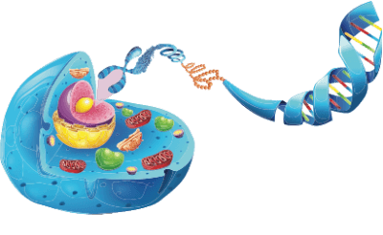
When ionising radiation gets inside the cell and damages the DNA without causing the cell to die, mutations occur.
DNA is a molecule found inside every single cell in your body. It contains all of the genetic information that tells the cell how to function properly.
If the DNA is damaged or altered, the cell can stop functioning properly, and can even develop into a cancer cell.

Slide 11
Mutations caused by radiation are unlikely to turn someone into the Incredible Hulk.
Instead, mutations that prevent the cell from functioning correctly are likely to occur. This also depends on the amount of radiation the person is exposed to.
A small amount of radiation might cause a few mutations that do not have a major effect on the cell. A large amount of radiation might cause many mutations that prevent the cell from functioning at all, causing it to die.

Slide 12
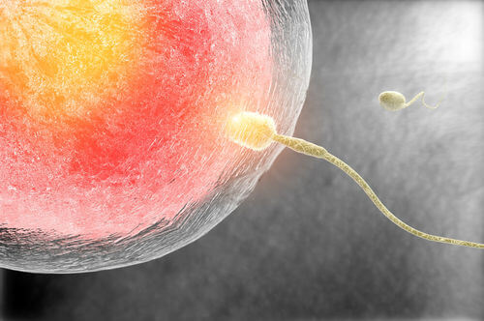
If the radiation causes a mutation in the gametes (egg or sperm cells), this mutation can be passed on to the organism's offspring.
This is called an inherited mutation.
Studies of men who worked with radioactive materials found that these men were more likely to have children who developed leukaemia than men who did not work with radioactive materials.

Slide 13
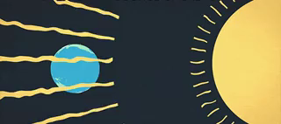
You are exposed to ionising radiation every day from various sources including the Sun, bananas and other humans.
However, this is not usually harmful because of the amount of radiation you are exposed to. The amount of radiation that is absorbed is called the dose.

Slide 14
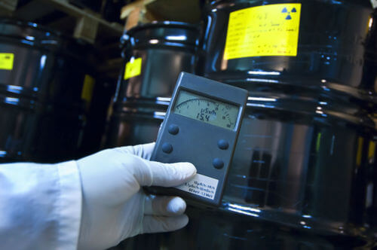
The amount of radiation that is absorbed in a specified amount of time is called the dose.
A dose of radiation is measured in sieverts, which have the symbol Sv. Sieverts are a measure of the health risk of ionising radiation on the human body.
1 Sv is an extremely large dose of radiation that will cause severe radiation sickness, so doses are usually measured in microsieverts (μSv). 1 microsievert is one millionth of a sievert.

Slide 15
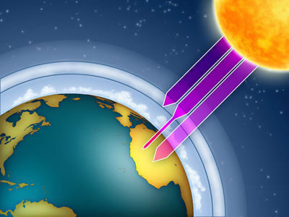
Every year, the average dose of radiation you receive is approximately 1700μSv.
About 1400μSv is from terrestrial radiation (radiation from radioisotopes in the ground) and about 300μSv is from cosmic radiation (radiation from radioisotopes in outer space). These doses are very small, so they are considered harmless.

Slide 16
